Slide 1
WELCOME TO Cafe4X
Cafe4X Connect: Tap, Taste, Enjoy!

Slide 2
Introduction
Cafe4x helps the Organizations to Manage the Food & Beverage services in the large offices and working spaces.
Users can browse the menu by scanning the QR, place orders, and customize their selections directly through their Mobile.
It streamlines the ordering process, reducing wait times and improving customer satisfaction. Integrated payment options allow for cashless transactions, enhancing convenience and security.
This Cafe4x app can collect customer feedback and provide analytics to improve service and menu offerings over time.

Slide 3
It serves several purpose:
Ordering Convenience
Menu Management
Efficiency
Payment Integration
Feedback and Analytics
Overall, our cafe4x application enhances the dining experience by making it more convenient, efficient, and transparent for both customers and cafeteria operators.

Slide 4
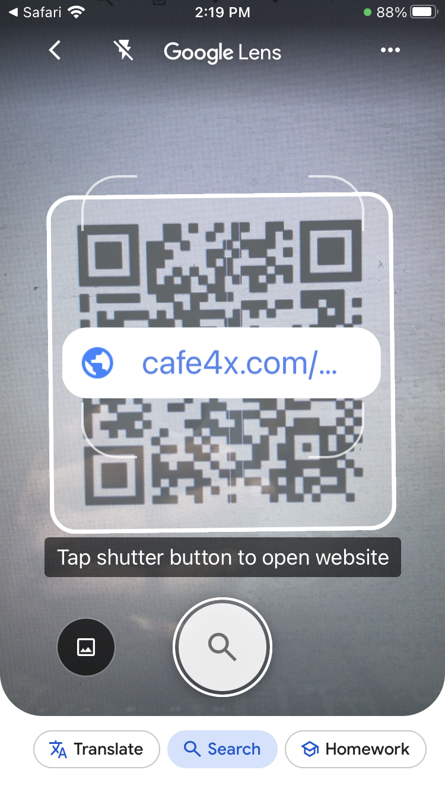
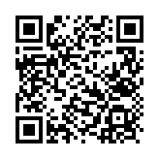
QR Code Scanning (End User Screen)
By Scanning the QR Code, the user will get into the items list page.

Slide 5
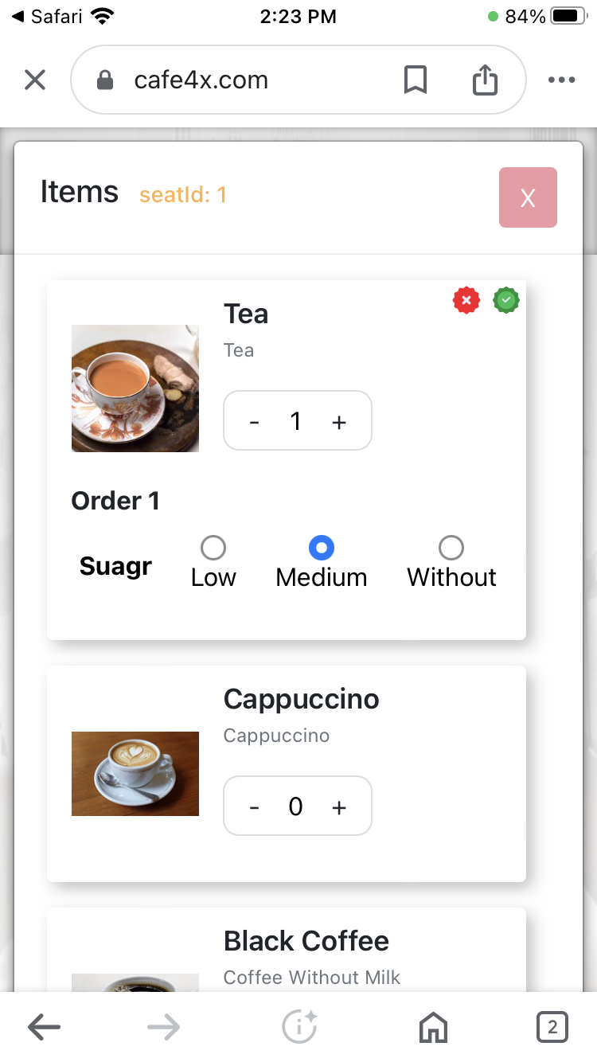
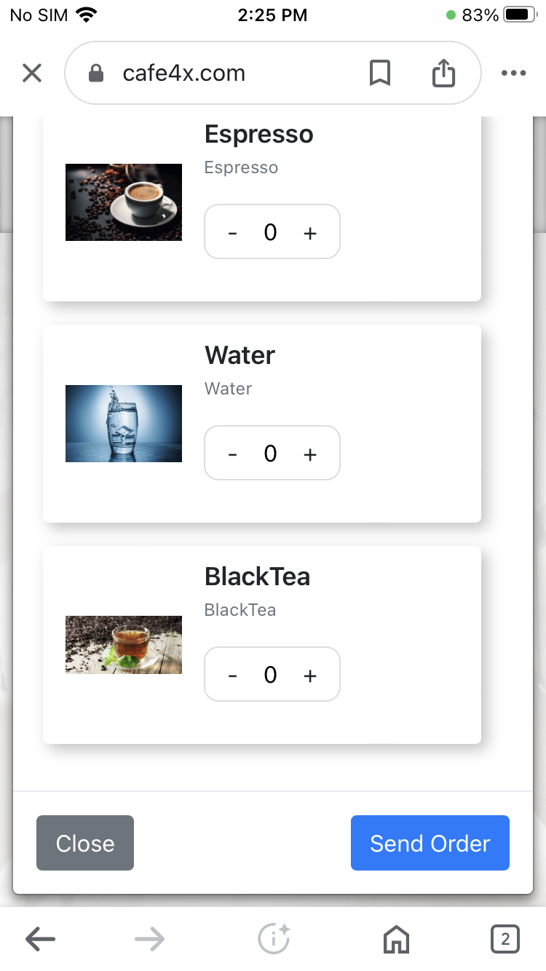
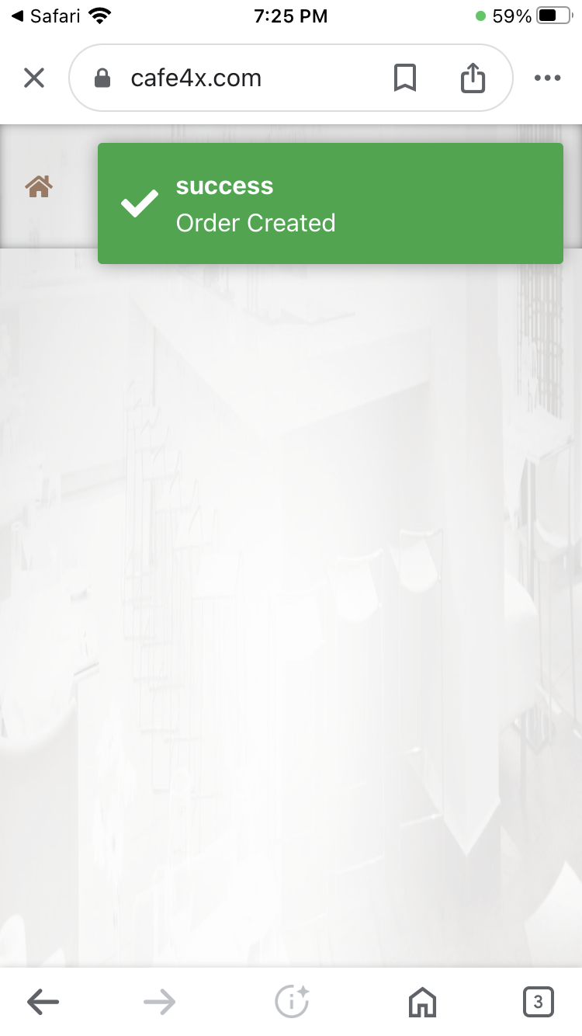
Items list page (End User Screen)
This is the items list page, that the user can visible after scanning the QR code. Here, the user can select items with preferences and click send order to place the order. Also the user can edit the order and update the changes in order or place a new order.

Slide 6
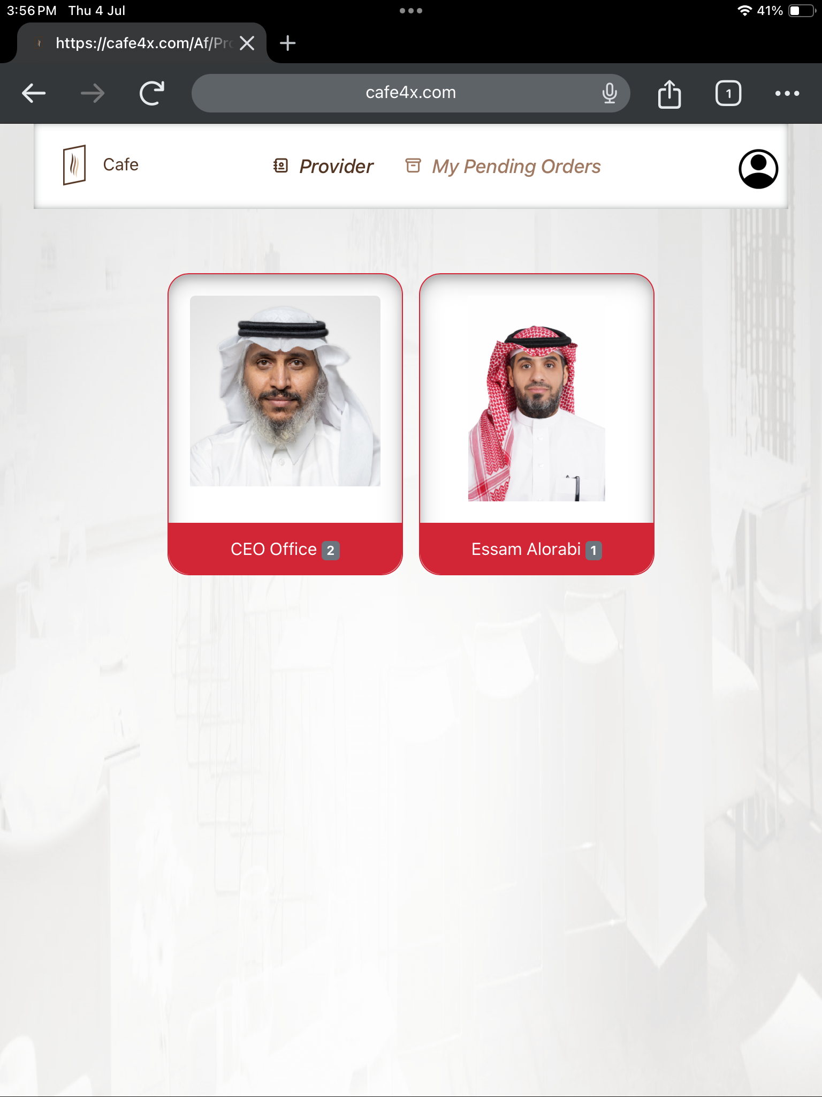
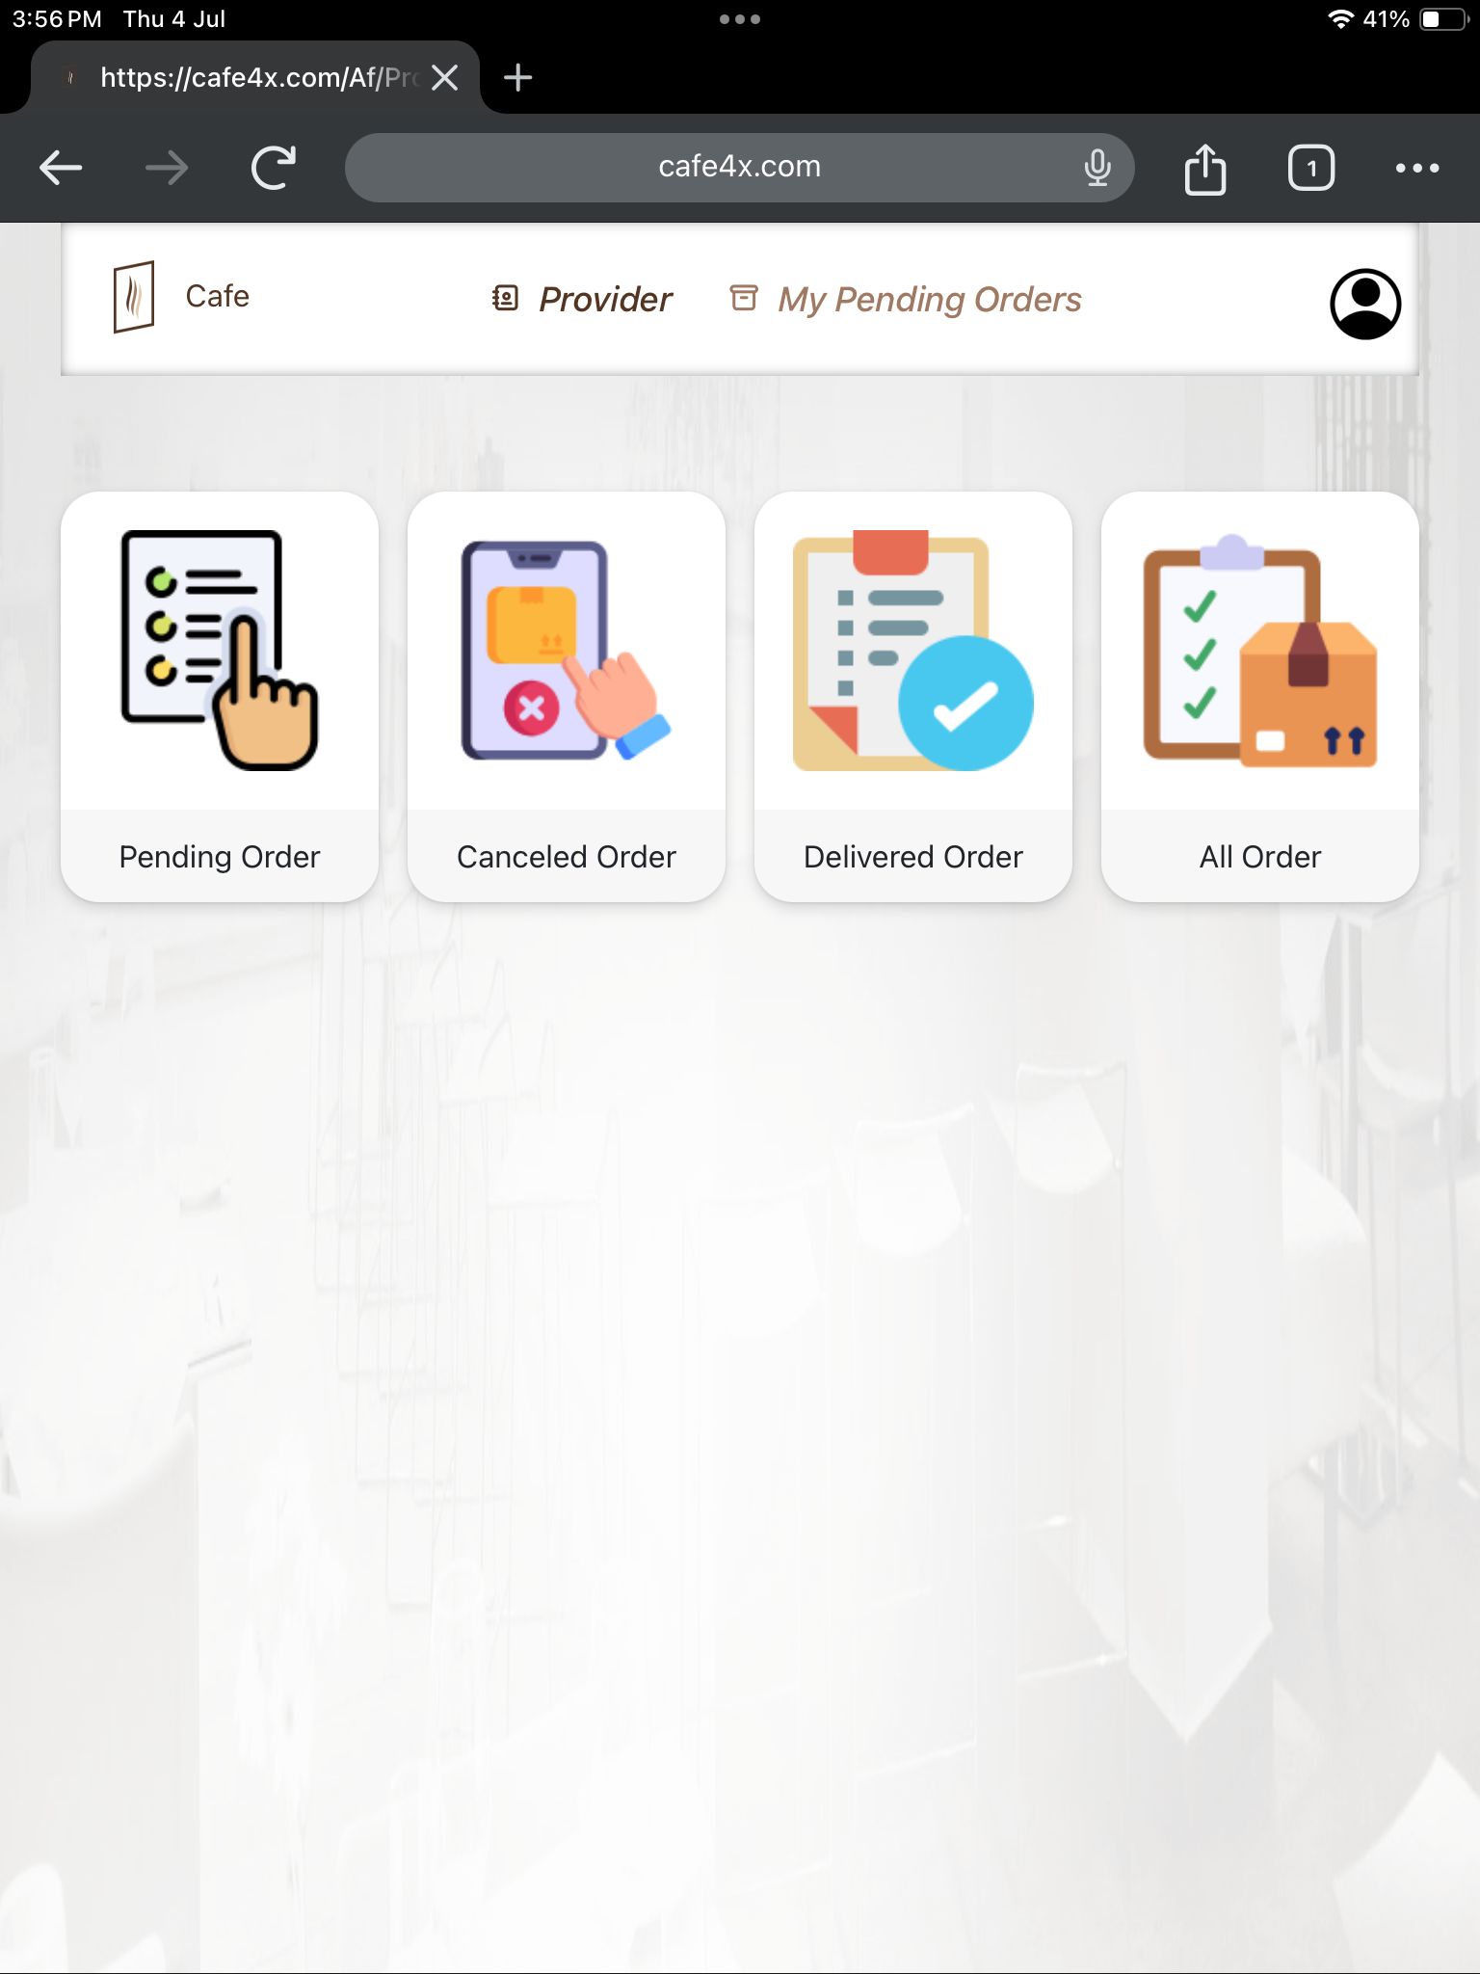
Provider’s page (Provider’s Screen)
This is a screen get by the providers to view the pending orders from every locations with pending counts.
Each and locations has a lists of Pending orders, Cancelled orders, Delivered orders and All orders.

Slide 7
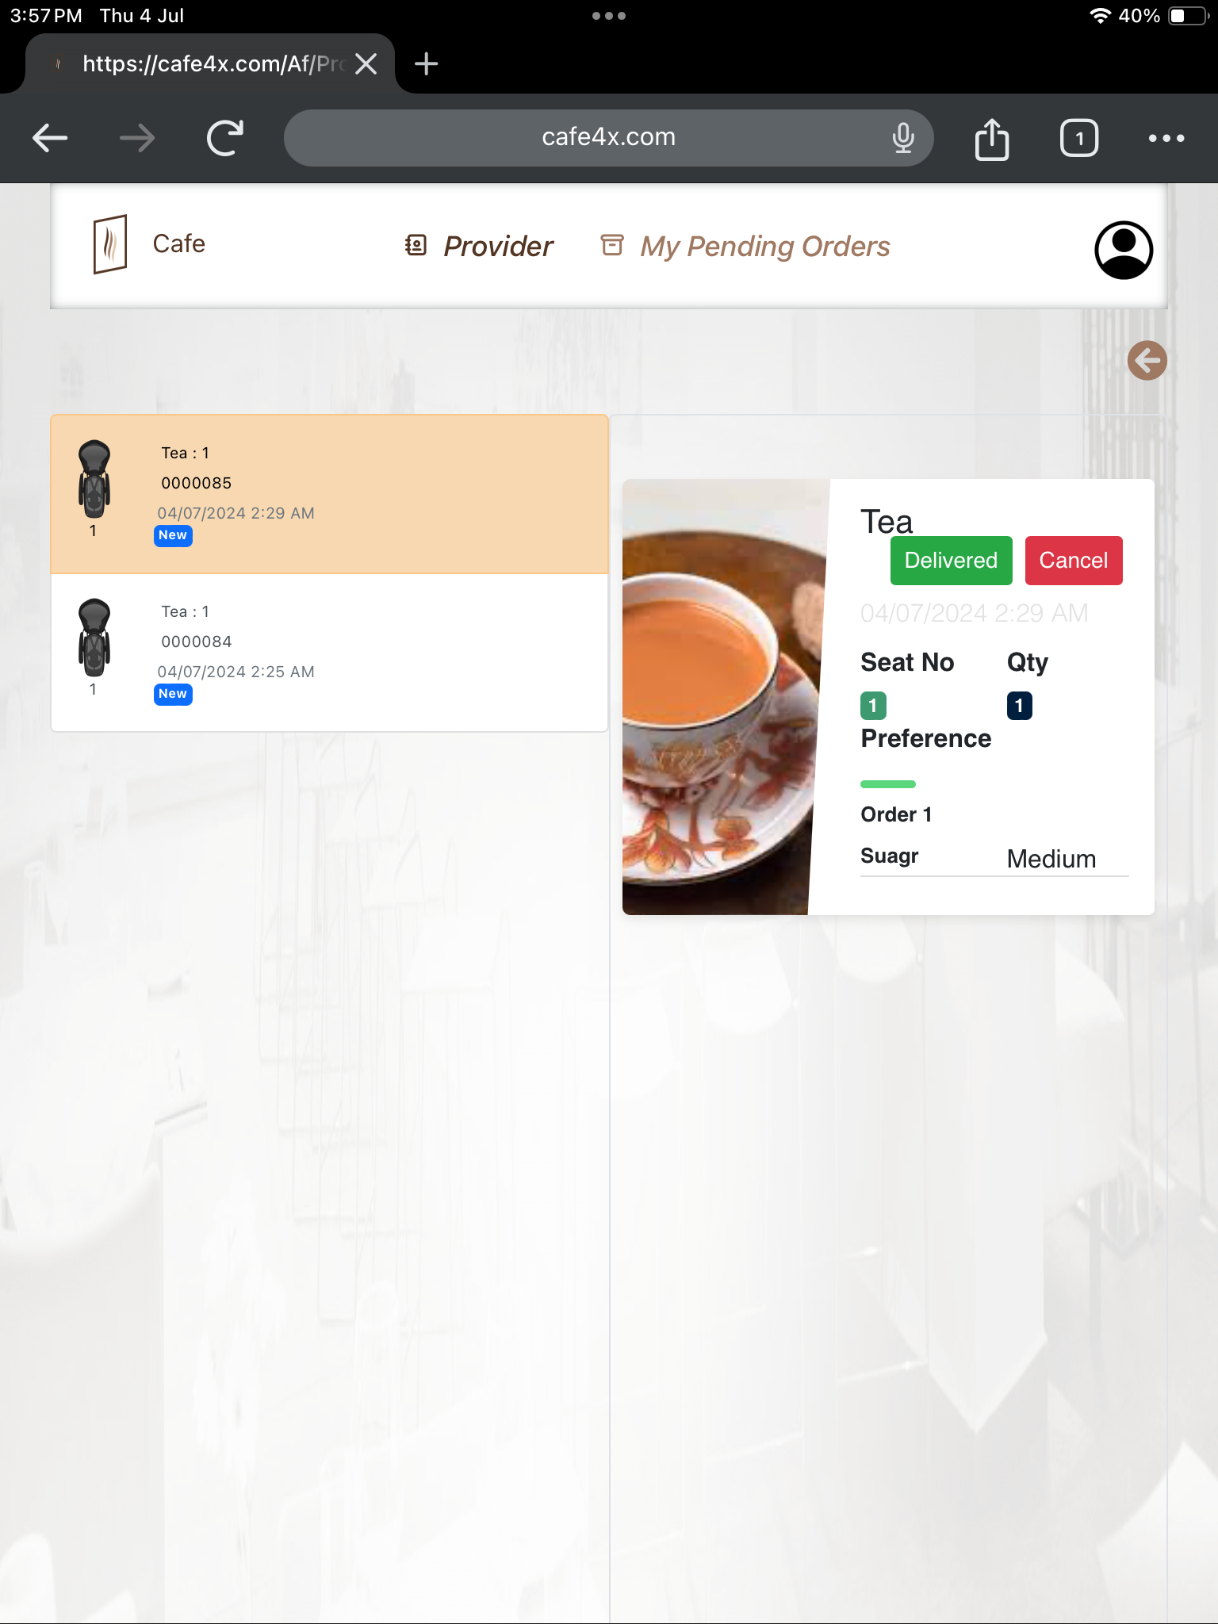
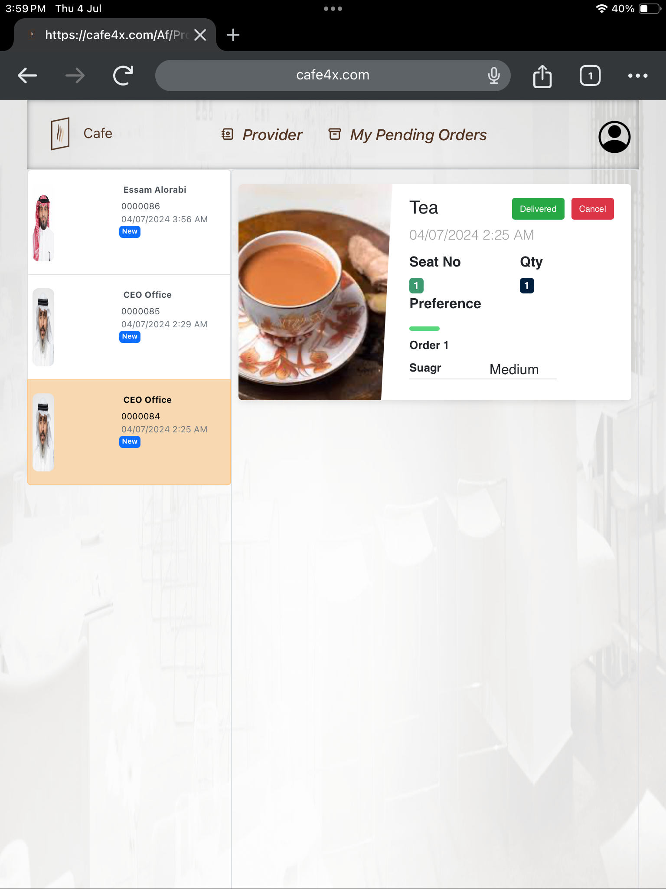
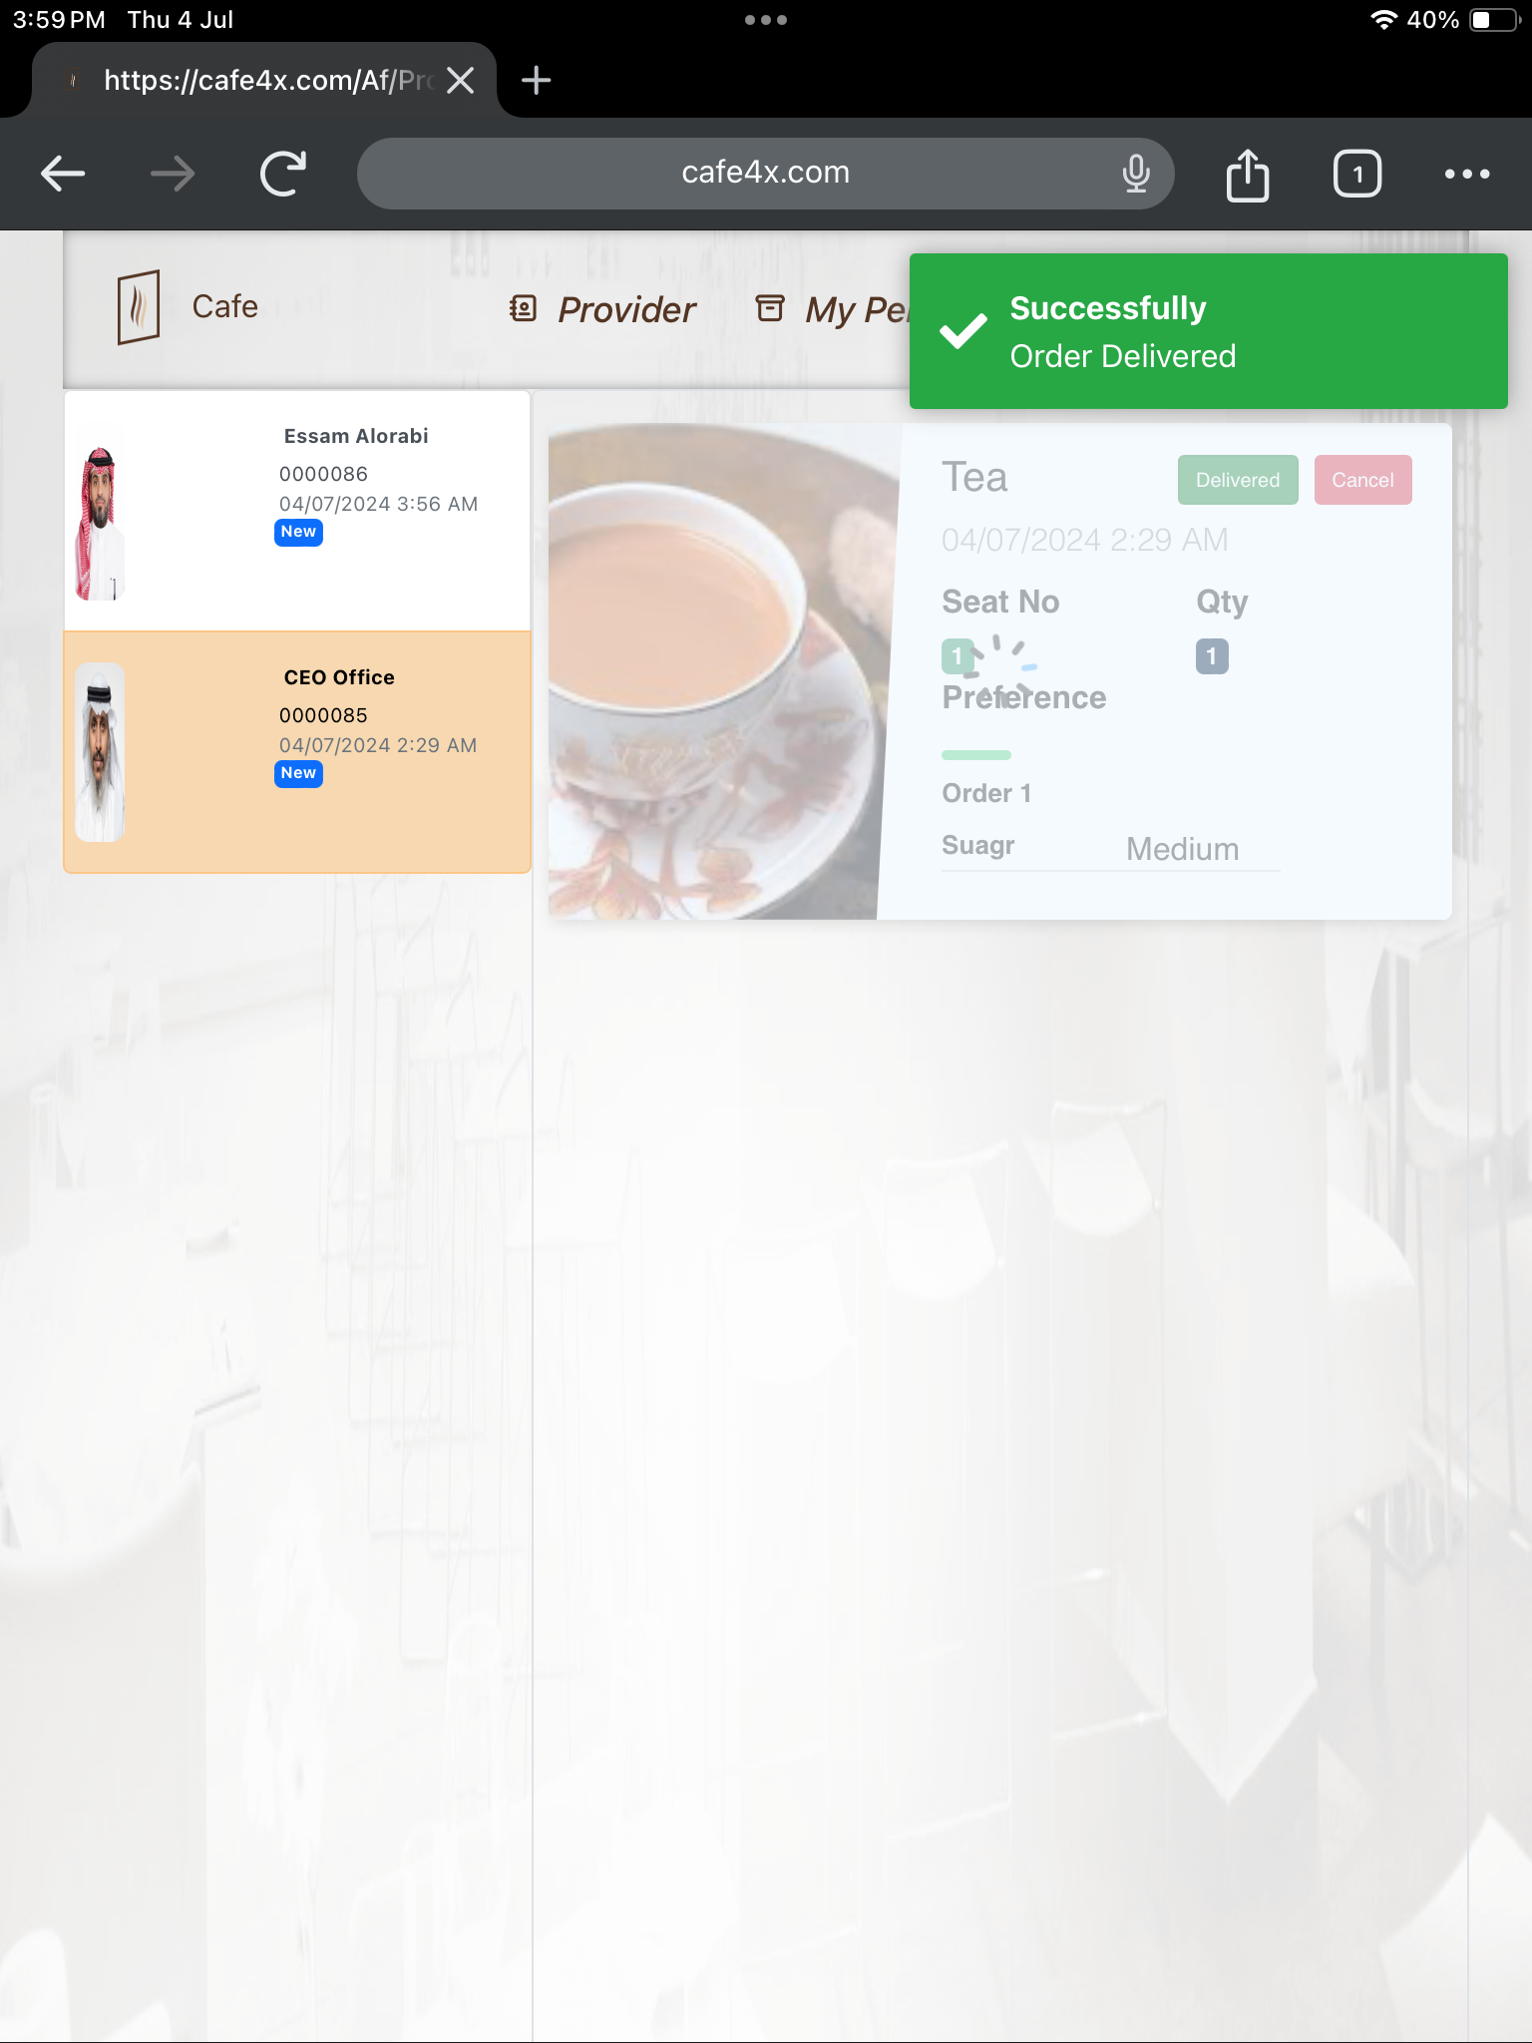
Here is the lists of orders and the over all pending orders list shown in the My Pending Orders list.
In this page providers can cancel the orders or update the orders status as delivered after order has been delivered.

Slide 8
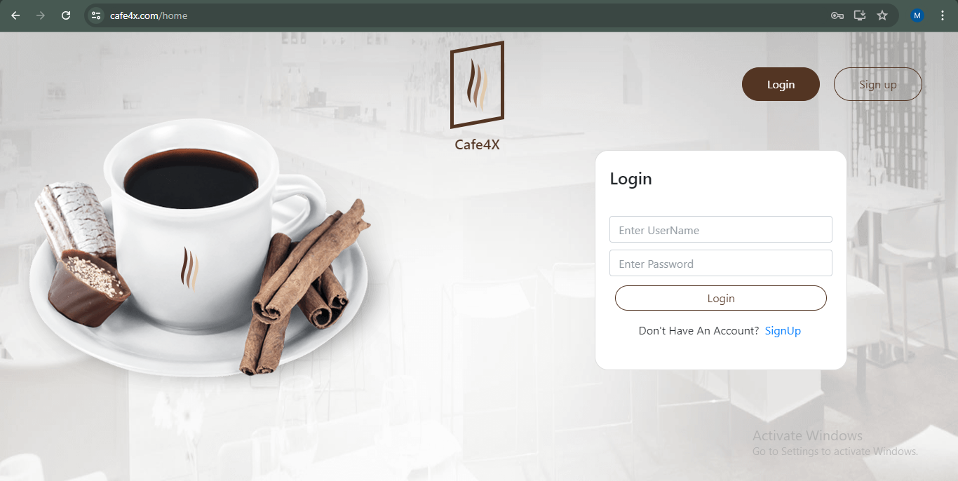
Login Page (Admin)
This is the Login page of our Cafe4x application.

Slide 9
A New user should Sign up here with his Organization details
An Existing user can Login here with username and password.
There is only a two user type to Login as a Admin or Provider.
Admin has a different screen from provider’s screen to administrate the app access to create, edit and delete the users, locations, location seats and items.
Provider has a different screen to manage order status to cancel or delivery orders.

Slide 10
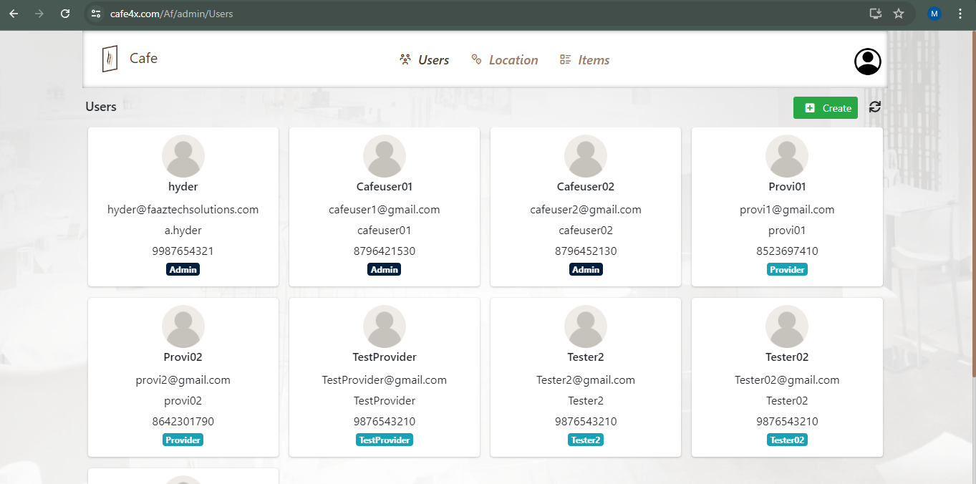
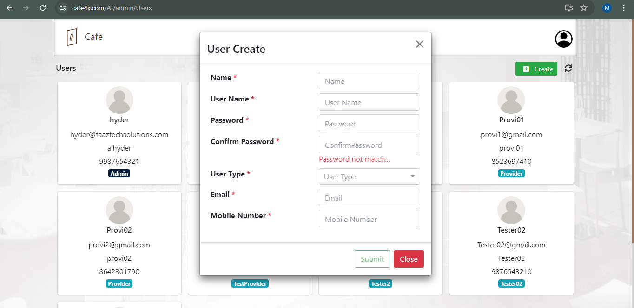
Cafe4x Users ( Admin’s Screen)
Admin or Administrator can create the users here to access the application.
Admin should choose the user type whether the user is an Admin or a Provider.
An Admin can able to edit or delete the users.

Slide 11
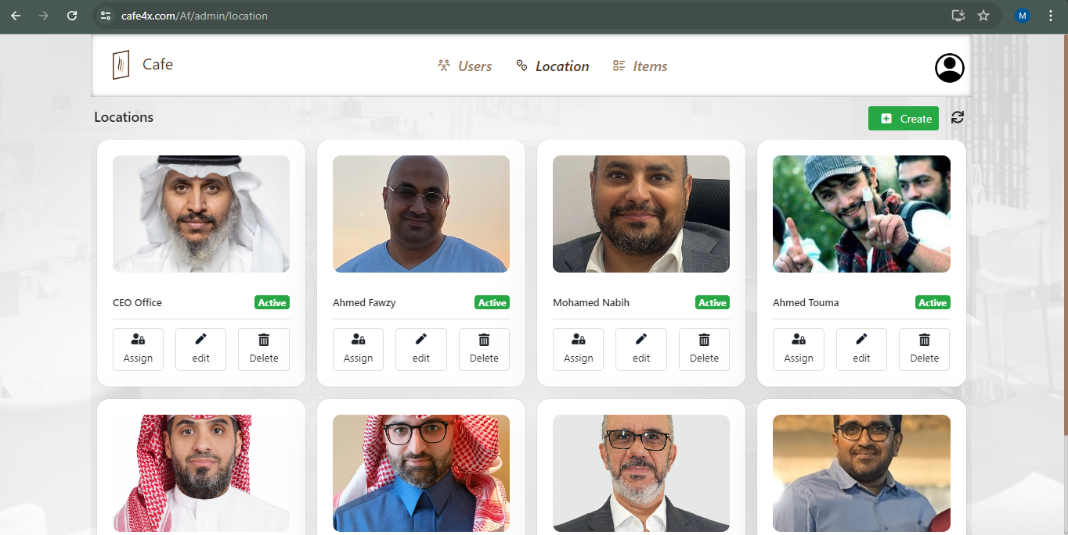
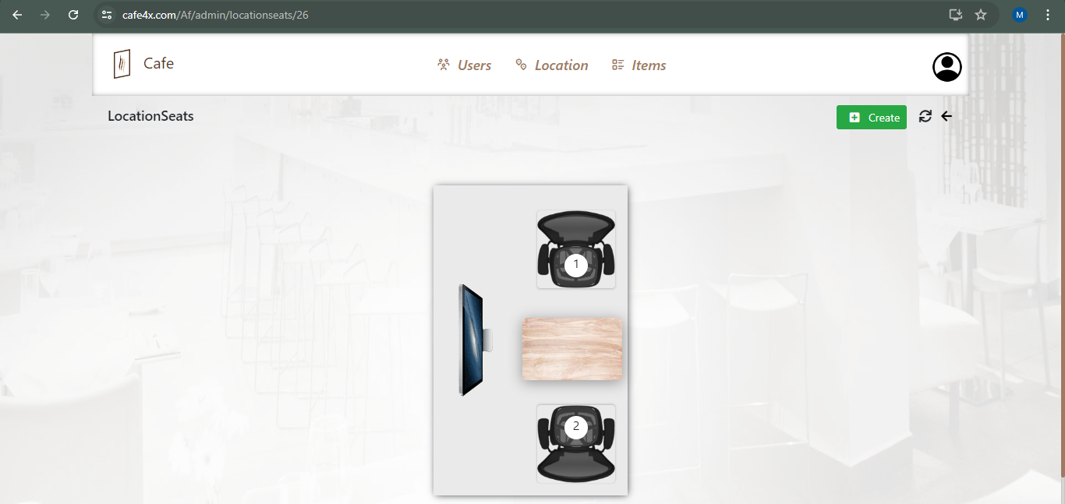
Location (Admin’s Screen)
An Admin can create location for the users.
Admin can assign providers for the location to deliver the orders.
Also admin can active and inactive locations while the location or location user is unavailable.
Admin can do edit or delete the locations or location users.

Slide 12
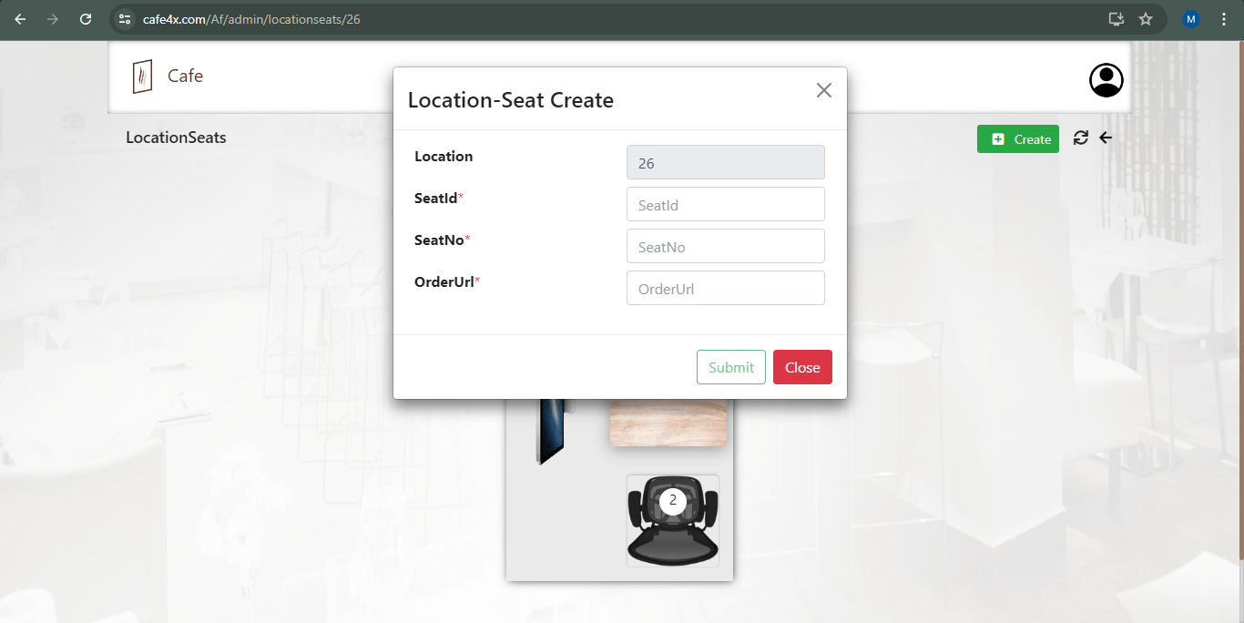
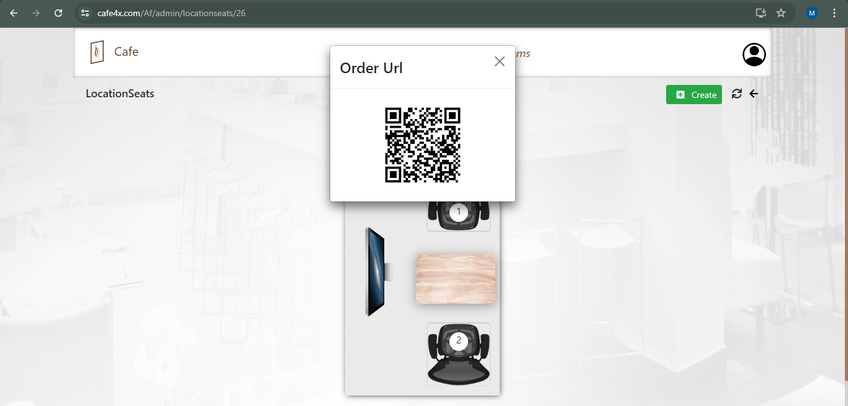
Location Seats QR Code (Admin’s Screen)
Here Admin can create location seats and generate QR Code for the end users.
This QR code can download and take print out to paste in End user’s location.
Admin can do edit or delete the location seats.

Slide 13
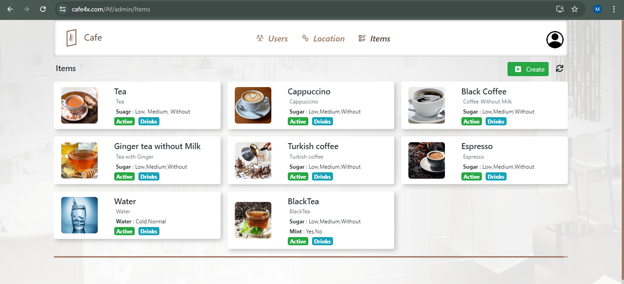
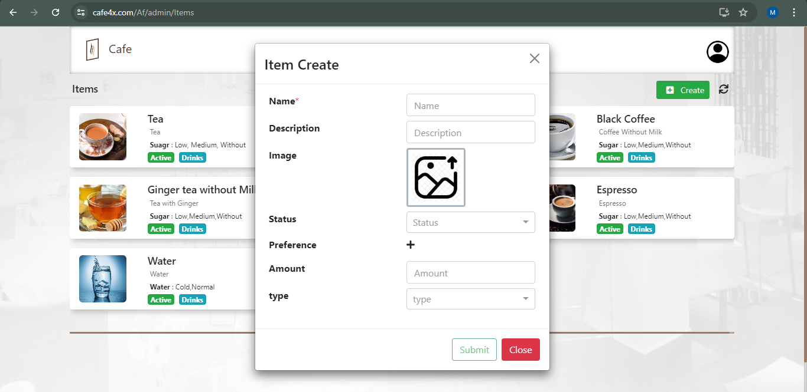
Cafe Items (Admin’s Screen)
This is an Items management page, here admin can add available items in cafeteria.
An Admin can add items with item’s name, image, description, preference, amount and status whether it is available or not.
Admin can edit and update items to change any fields in the list, even he can delete the items.

Slide 14
Benefits and Advantages of Cafe4x application
Efficiency and Time Savings:
Streamlined ordering process reduces wait times.
Pre-ordering and scheduling feature saves time during busy periods.
Integrated payment options facilitate quicker transactions.
Improved Customer Experience:
User-friendly interface enhances ease of ordering.
Customizable preferences cater to individual dietary needs.
Cost Savings and Revenue Generation:
Reduced labour costs through efficient ordering and payment processes.
Streamlined operations allow cafeteria staff to focus more on food preparation and beverage service rather than order taking and payment processing.

Slide 15
Staff Productivity and Satisfaction:
Clear communication channels between kitchen and front-of-house staff.
Reduced errors in order fulfilment improve staff efficiency and morale.
Scalability and Adaptability:
Cloud-based architecture supports scalability as your cafeteria grows.
Flexible customization options adapt to changing business needs.
Compliance and Safety:
Compliance with food safety regulations through digital record-keeping.
Audit trails for transparency and accountability.

Slide 16
Market Opportunity
The market potential for a cafeteria application can be substantial, driven by several factors and trends in the food service industry.
Growing Demand for Efficiency and Convenience:
Corporate Cafeterias: Many companies are looking for ways to improve efficiency and streamline cafeteria operations to cater to employees' needs quickly and conveniently.
Educational Institutions: Schools and universities often seek solutions to manage large volumes of students efficiently during meal times.
Healthcare Facilities: Hospitals and healthcare facilities require efficient dining solutions to serve patients, visitors, and staff.
Shift Towards Digital Solutions:
There is an increasing adoption of digital and mobile solutions across various industries, including food service.

Slide 17
Employees, students, and visitors expect modern, convenient ways to order and pay for meals.
Focus on Health and Safety:
Digital menu management and ordering reduce physical contact and enhance food safety practices.
Compliance with health regulations and allergen management are critical features that appeal to health-conscious persons.
Market Size and Growth:
The food service industry continues to grow globally, with an increasing emphasis on technology-driven solutions to improve user experience and operational efficiency.
Market research indicates a growing demand for digital solutions in food service, making it an opportune time to introduce our Cafe4x application.

Slide 18
Conclusion
Our Cafe4x application represents a significant leap forward in enhancing the dining experience for both employee and guest alike.
Our goal is to transform the way cafeterias function by simplifying ordering processes, enhancing menu management, and promoting smooth communication.
We are excited about the possibilities this innovation brings and look forward to partnering with you to create smarter, more efficient cafeteria environments. Thank you for your attention and we welcome any questions you may have.

